Slide 1
Public Key Cryptography
FALGUNI ROY
INSTITUTE OF INFORMATION TECHNOLOGY
NSTU

Slide 2
Private-Key Cryptography
Traditional private/secret/single key cryptography uses one key
Key is shared by both sender and receiver
If the key is disclosed communications are compromised
Also known as symmetric, both parties are equal
  Hence does not protect sender from receiver forging a message & claiming is sent by sender .
Notes:
So far all the cryptosystems discussed have been private/secret/single key (symmetric) systems. All classical, and modern block and stream ciphers are of this form.

Slide 3
Public-Key Cryptography
Probably most significant advance in the 3000 year history of cryptography
Uses two keys – a public key and a private key
Asymmetric since parties are not equal
Uses clever application of number theory concepts to function
Complements rather than replaces private key cryptography
In 1976 Diffie and Hellman Introduced public-key cryptography
Based on mathematical calculation
Notes:
Will now discuss the radically different public key systems, in which two keys are used. Anyone knowing the public key can encrypt messages or verify signatures, but cannot decrypt messages or create signatures, counter-intuitive though this may seem. It works by the clever use of number theory problems that are easy one way but hard the other. Note that public key schemes are neither more secure than private key (security depends on the key size for both), nor do they replace private key schemes (they are too slow to do so), rather they complement them.

Slide 4
Public-Key Cryptography
public-key/two-key/asymmetric cryptography involves the use of two keys:
  a public-key, which may be known by anybody, and can be used to encrypt messages, and verify signatures
  a private-key, known only to the recipient, used to decrypt messages, and sign (create) signatures
Asymmetric because
  those who encrypt messages or verify signatures cannot decrypt messages or create signatures

Slide 5
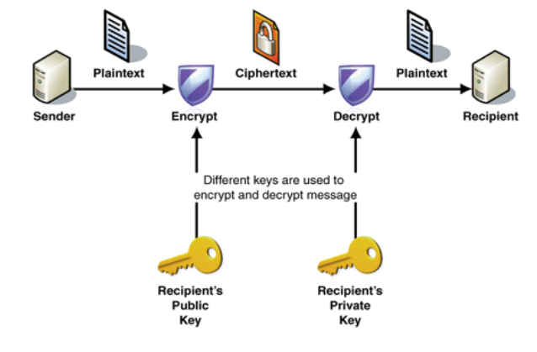
Public-Key Cryptography
Notes:
Stallings Fig 9-1.

Slide 6
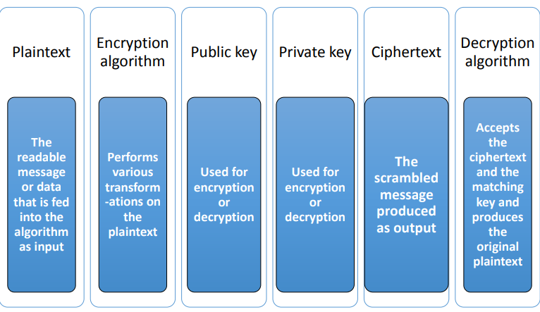
Public-Key Cryptosystems
A public-key encryption scheme has six ingredients:

Slide 7
Principles of Public-Key Cryptosystems
The concept of public-key cryptography evolved from an attempt to attack two of the most difficult problems associated with symmetric encryption:
  Key distribution – how to have secure communications in general without having to trust a KDC with your key
  Digital signatures – how to verify a message comes intact from the claimed sender
Notes:
The idea of public key schemes, and the first practical scheme, which was for key distribution only, was published in 1977 by Diffie & Hellman. The concept had been previously described in a classified report in 1970 by James Ellis (UK CESG) - and subsequently declassified in 1987. See History of Non-secret Encryption (at CESG). Its interesting to note that they discovered RSA first, then Diffie-Hellman, opposite to the order of public discovery!

Slide 8
Public-Key Characteristics
Public-Key algorithms rely on two keys with the characteristics that it is:
  computationally infeasible to find decryption key knowing only algorithm & encryption key
  computationally easy to en/decrypt messages when the relevant (en/decrypt) key is known
  either of the two related keys can be used for encryption, with the other used for decryption (in some schemes)
Notes:
Public key schemes utilise problems that are easy (P type) one way but hard (NP type) the other way, eg exponentiation vs logs, multiplication vs factoring. Consider the following analogy using padlocked boxes: traditional schemes involve the sender putting a message in a box and locking it, sending that to the receiver, and somehow securely also sending them the key to unlock the box. The radical advance in public key schemes was to turn this around, the receiver sends an unlocked box to the sender, who puts the message in the box and locks it (easy - and having locked it cannot get at the message), and sends the locked box to the receiver who can unlock it (also easy), having the key. An attacker would have to pick the lock on the box (hard).

Slide 9
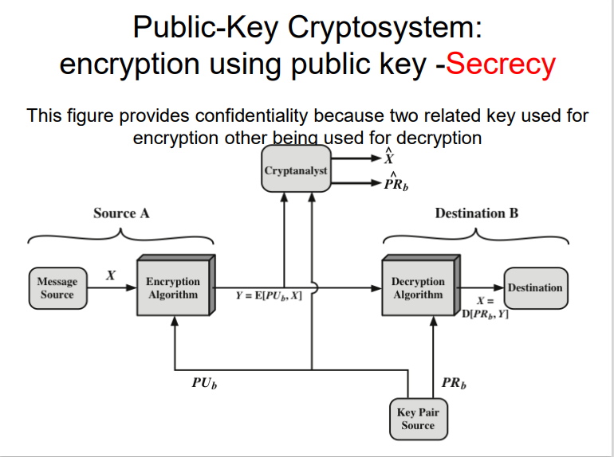

Slide 10
CONFIDENTIALITY
protecting the information from disclosure to unauthorized parties.
ensures that only the right people (people who knows the key) can read the information.

Slide 11
How PKC works when Confidentiality is needed
Each system generates a pair of keys.
Each system publishes its public key keeping its companion key private.
If source A wishes to send a message to source B then it encrypts the message using source B’s public key.
When source B receives the message, it decrypts the message using its private key. No one else can decrypt the message because only source B knows its private key.

Slide 12
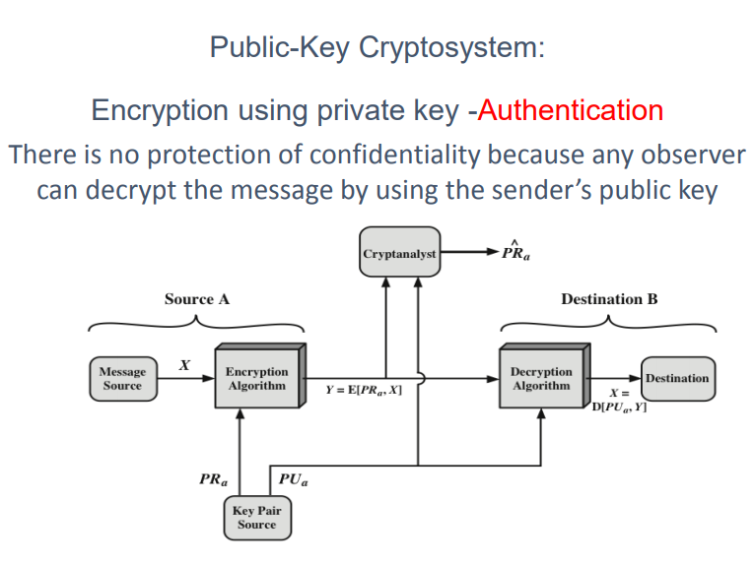
The sender and receiver can confirm each other’s identity and origin/destination of the information

Slide 13
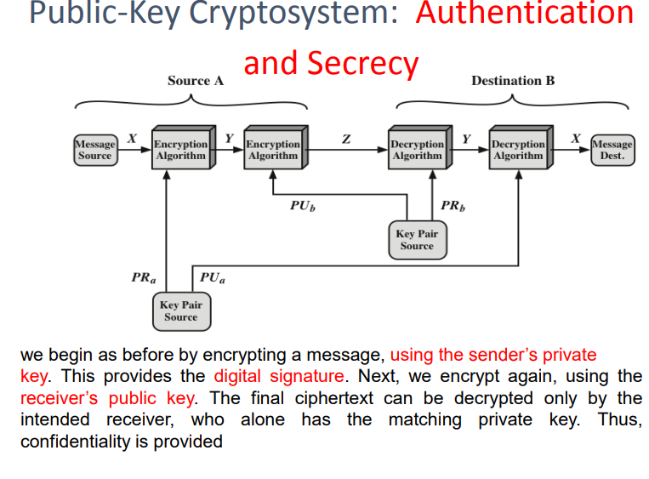

Slide 14
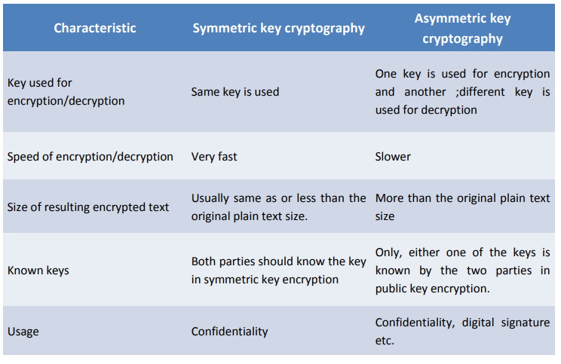
DIFFERENCE BETWEEN SYMMETRIC AND ASYMMETRIC KEY CRYPTOGRAPHY

Slide 15
Public-Key Applications
Can classify uses into 3 categories:
  encryption/decryption (provide secrecy)
  digital signatures (provide authentication)
  key exchange (of session keys)
some algorithms are suitable for all uses, others are specific to one

Slide 16
Security of Public Key Schemes
like private key schemes brute force exhaustive search attack is always theoretically possible
But keys used are too large (>512bits)
Security relies on a large enough difference in difficulty between easy (en/decrypt) and hard (cryptanalyse) problems
more generally the hard problem is known, its just made too hard to do in practise
requires the use of very large numbers
hence is slow compared to private key schemes
Notes:
Public key schemes are no more or less secure than private key schemes - in both cases the size of the key determines the security. Note also that you can't compare key sizes - a 64-bit private key scheme has very roughly similar security to a 512-bit RSA - both could be broken given sufficient resources. But with public key schemes at least there's usually a firmer theoretical basis for determining the security since its based on well-known and well studied number theory problems.

Slide 17
Public-Key Requirements
It is computationally easy for a party B to generate a pair (public key PUb, private key PRb)
It is computationally easy for a sender A, knowing the public key and the message to be encrypted, to generate the corresponding ciphertext
It is computationally easy for the receiver B to decrypt the resulting ciphertext using the private key to recover the original message
It is computationally infeasible for an adversary, knowing the public key, to determine the private key.
It is computationally infeasible for an adversary, knowing the public key and a ciphertext, to recover the original message.
The two keys can be applied in either order.

Slide 18
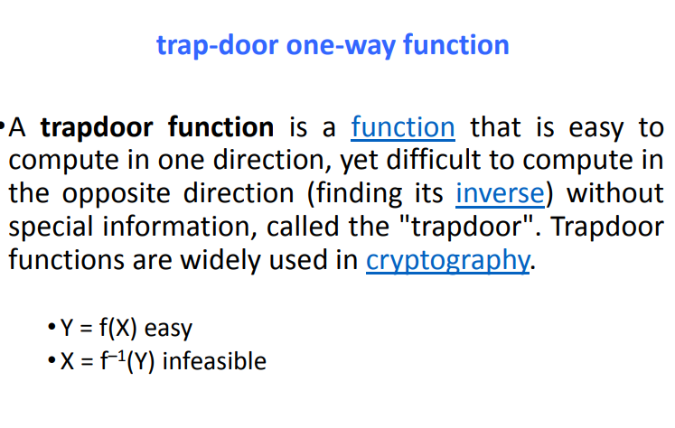
Public-Key Requirements

Slide 19
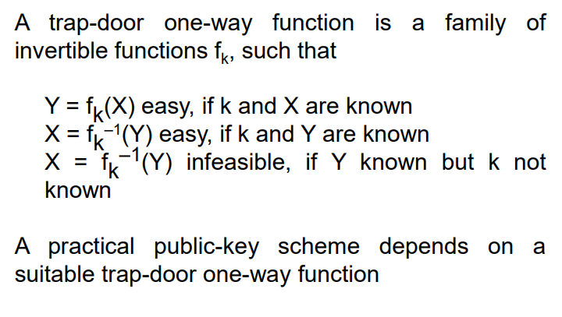
Public-Key Requirements

Slide 20
Knapsack cryptosystems
Knapsack Cryptosystems are cryptosystems which security is based on the hardness of solving the knapsack problem
  a set of items, each with a weight and a value, determine the number of each item to include in a collection so that the total weight is less than or equal to a given limit and the total value is as large as possible.
Knapsack Encryption Algorithm is the first general public key cryptography algorithm.
It is developed by Ralph Merkle and Mertin Hellman in 1978.
As it is a Public key cryptography, it needs two different keys.
One is Public key which is used for Encryption process and the other one is Private key which is used for Decryption process.
In this algorithm, two different knapsack problems is used in which one is easy and other one is hard.
The easy knapsack is used as the private key and the hard knapsack is used as the public key.
The easy knapsack is used to derived the hard knapsack.

Slide 21
Knapsack cryptosystems
For the easy knapsack, choose a Super Increasing knapsack problem.
Super increasing knapsack is a sequence in which every next term is greater than the sum of all preceding terms.
{1, 2, 4, 10, 20, 40} is a super increasing as
1<2, 1+2<4, 1+2+4<10, 1+2+4+10<20 and 1+2+4+10+20<40.
Step-1: Choose a super increasing knapsack {1, 2, 4, 10, 20, 40} as the private key.
Step-2:
  Choose two numbers n and m.
  The value of m must be greater then the sum of all values in private key, for example 110.
  And the number n should have no common factor with m, for example 31.
  Multiply all the values of private key by the number n and then find modulo m.
Step-3: Calculate the values of Public key using m and n.

Slide 22
Knapsack cryptosystems
{1, 2, 4, 10, 20, 40} is the private key.
1x31 mod(110) = 31
2x31 mod(110) = 62
4x31 mod(110) = 14
10x31 mod(110) = 90
20x31 mod(110) = 70
40x31 mod(110) = 30
{31, 62, 14, 90, 70, 30} is the public key

Slide 23
Example
plain text is 100100111100101110.
Encryption
  knapsacks contain six values, so split the plain text in a groups of six
  100100 111100 101110
  Multiply each values of public key with the corresponding values of each group and take their sum.
  100100 {31, 62, 14, 90, 70, 30}
  1x31+0x62+0x14+1x90+0x70+0x30 = 121
  111100 {31, 62, 14, 90, 70, 30}
  1x31+1x62+1x14+1x90+0x70+0x30 = 197
  101110 {31, 62, 14, 90, 70, 30}
  1x31+0x62+1x14+1x90+1x70+0x30 = 205
  cipher text is 121 197 205.

Slide 24

Example
Decryption
  The receiver receive the cipher text which has to be decrypt.
  The receiver also knows the values of m and n.
  So, first need to find the n^-1, which is multiplicative inverse of n mod m
  multiply 71 with each block of cipher text take modulo m.
  121 x 71 mod(110) = 11
  make the sum of 11 from the values of private key {1, 2, 4, 10, 20, 40}
  1+10=11 so make that corresponding bits 1 and others 0 which is 100100.
  197 x 71 mod(110) = 17
  1+2+4+10=17 = 111100
  And, 205 x 71 mod(110) = 35
  1+4+10+20=35 = 101110
  100100111100101110 which is the plain text.

Slide 25
RSA Algorithm
RSA is the algorithm used by modern computers to encrypt and decrypt messages.
It is an asymmetric cryptographic algorithm.
One of the first successful responses to the challenge was Developed in 1977 at MIT by Ron Rivest, Adi Shamir & Len Adleman
best known & widely used public-key scheme
RSA is the first practical public-key cryptosystems and is widely used for secure data transmission
Notes:
RSA is the best known, and by far the most widely used general public key encryption algorithm.

Slide 26
RSA Algorithm
Every number has a prime factorization and it is hard to find if the number is very large. The time complexity is also very high. But on the other hand the multiplication is easy and time complexity is also not very high.
  For example the multiplication of 15 and 30 is 450 but the prime factorization of 450 is not easy and also it takes more time as compare to multiplication
The RSA algorithm involves three steps:
  key generation,
  encryption and
  decryption.

Slide 27
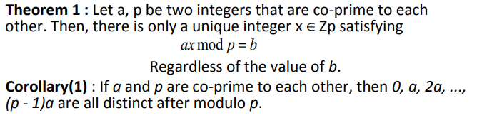
Mathematics behind RSA

Slide 28

Mathematics behind RSA
Theorem 2(Fermat’s Little Theorem) : if n is a prime, and a is any integer co-prime to n, then a^{n}
  – a is divisible by n without remainder

Slide 29
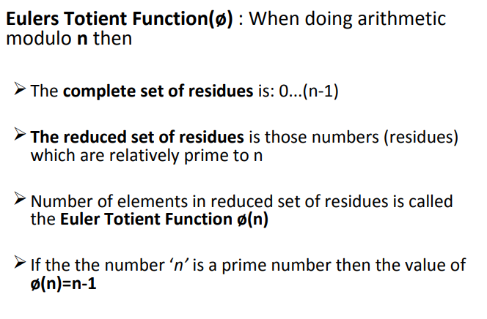
Mathematics behind RSA

Slide 30
Euler's totient function counts the positive integers up to a given integer n that are relatively prime to n.
It is written using the Greek letter phi as φ(n) or ϕ(n), and may also be called Euler's phi function.
In other words, it is the number of integers k in the range 1 ≤ k ≤ n for which the greatest common divisor gcd(n, k) is equal to 1
For example, a complete residue system modulo 12 is {1, 2, 3, 4, 5, 6, 7, 8, 9, 10, 11}.
The so-called totatives 1, 5, 7 and 11 are the only integers in this set which are relatively prime to 12,
the corresponding reduced residue system modulo 12 is {1, 5, 7, 11}.

Slide 31
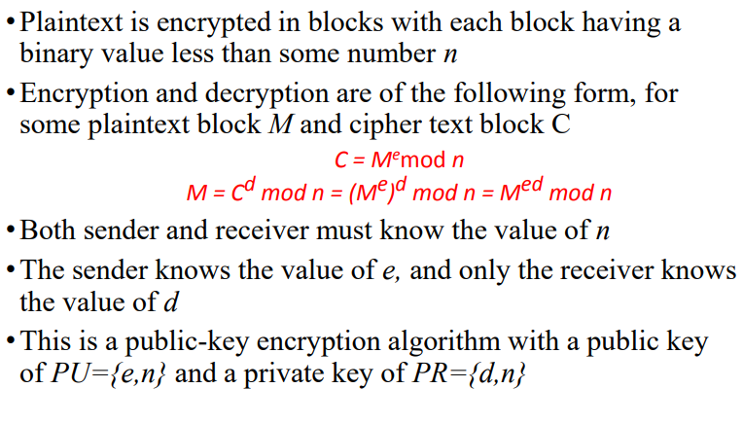
RSA Algorithm

Slide 32
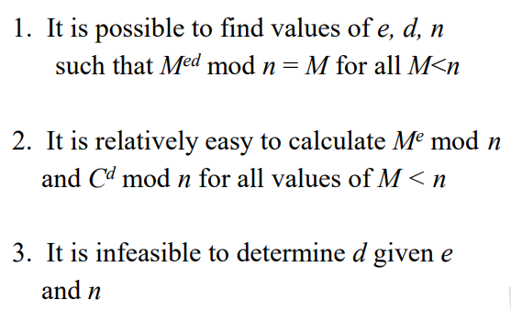
Algorithm Requirements
For this algorithm to be satisfactory for public-key encryption, the following requirements must be met:

Slide 33
RSA Key Setup
each user generates a public/private key pair by:
selecting two large primes at random - p, q
computing their system modulus N=p.q
  note ø(N)=(p-1)(q-1)
selecting at random the encryption key e
    where 1<e<ø(N), gcd(e,ø(N))=1
solve following equation to find decryption key d
  e.d=1 mod ø(N) and 0≤d≤N
publish their public encryption key: KU={e,N}
keep secret private decryption key: KR={d,p,q}
Notes:
This key setup is done once (rarely) when a user establishes (or replaces) their public key. The exponent e is usually fairly small, just must be relatively prime to ø(N). Need to compute its inverse to find d. It is critically important that the private key KR={d,p,q} is kept secret, since if any part becomes known, the system can be broken. Note that different users will have different moduli N.

Slide 34
RSA Use
to encrypt a message M the sender:
  obtains public key of recipient KU={e,N}
  computes: C=Me mod N, where 0≤M<N
to decrypt the ciphertext C the owner:
  uses their private key KR={d,p,q}
  computes: M=C^{d} mod N
note that the message M must be smaller than the modulus N (block if needed)

Slide 35
Why RSA Works
because of Euler's Theorem:
a^{ø(n)}mod N = 1
  where gcd(a,N)=1
in RSA have:
  N=p.q
  ø(N)=(p-1)(q-1)
  carefully chosen e & d to be inverses mod ø(N)
  hence e.d=1+k.ø(N) for some k
hence :
C^{d} = (Me)^{d} = M^{1+k.ø(N)} = M¹.(M^{ø(N)})^{q} = M¹.(1)^{q} = M¹ = M mod N
Notes:
Can show that RSA works as a direct consequence of Euler’s Theorem.

Slide 36
RSA Example
Select primes: p=17 & q=11
Compute n = pq =17×11=187
Compute ø(n)=(p–1)(q-1)=16×10=160
Select e : gcd(e,160)=1; choose e=7
Determine d:
    de=1 mod 160 and d < 160
    Value is d=23 since 23×7=161= 10×160+1
Publish public key KU={7,187}
Keep secret private key KR={23,17,11}
Notes:
Here walk through example using “trivial” sized numbers.
Selecting primes requires the use of primality tests.
Finding d as inverse of e mod ø(n) requires use of Inverse algorithm (see Ch4)

Slide 37
RSA Example cont
sample RSA encryption/decryption is:
given message M = 88 (nb. 88<187)
encryption:
  C = 88⁷ mod 187 = 11
decryption:
  M = 11²³ mod 187 = 88
Notes:
Rather than having to laborious repeatedly multiply, can use the "square and multiply" algorithm with modulo reductions to implement all exponentiations quickly and efficiently (see next).

Slide 38
Exponentiation
can use the Square and Multiply Algorithm
a fast, efficient algorithm for exponentiation
concept is based on repeatedly squaring base
and multiplying in the ones that are needed to compute the result
look at binary representation of exponent
only takes O(log₂ n) multiples for number n
  eg. 7⁵ = 7⁴.7¹ = 3.7 = 10 mod 11
  eg. 3¹²⁹ = 3¹²⁸.3¹ = 5.3 = 4 mod 11

Slide 39
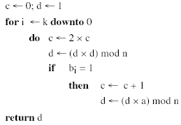
Exponentiation

Slide 40
RSA Key Generation
users of RSA must:
  determine two primes at random - p, q
  select either e or d and compute the other
primes p,q must not be easily derived from modulus N=p.q
  means must be sufficiently large
  typically guess and use probabilistic test
exponents e, d are inverses, so use Inverse algorithm to compute the other
Notes:
Both the prime generation and the derivation of a suitable pair of inverse exponents may involve trying a number of alternatives, but theory shows the number is not large.

Slide 41
RSA Security
three approaches to attacking RSA:
  brute force key search (infeasible given size of numbers)
  mathematical attacks (based on difficulty of computing ø(N), by factoring modulus N)
  timing attacks (on running of decryption)

Slide 42
Factoring Problem
mathematical approach takes 3 forms:
  factor N=p.q, hence find ø(N) and then d
  determine ø(N) directly and find d
  find d directly
currently believe all equivalent to factoring
  have seen slow improvements over the years
    as of Aug-99 best is 130 decimal digits (512) bit with GNFS
  biggest improvement comes from improved algorithm
    cf “Quadratic Sieve” to “Generalized Number Field Sieve”
  barring dramatic breakthrough 1024+ bit RSA secure
    ensure p, q of similar size and matching other constraints
Notes:
See Stallings Table 9-3 for progress in factoring.
Best current algorithm is the “Generalized Number Field Sieve” (GNFS), which replaced the earlier “Quadratic Sieve” in mid-1990’s. Do have an even more powerful and faster algorithm - the “Special Number Field Sieve” (SNFS) which currently only works with numbers of a particular form (not RSA like). However expect it may in future be used with all forms. Numbers of size 1024+ bits look reasonable at present, and the factors should be of similar size

Slide 43
Timing Attacks
developed in mid-1990’s
exploit timing variations in operations
  eg. multiplying by small vs large number
  or IF's varying which instructions executed
infer operand size based on time taken
RSA exploits time taken in exponentiation
countermeasures
  use constant exponentiation time
  add random delays
  blind values used in calculations

Slide 44
Summary
have considered:
  principles of public-key cryptography
  RSA algorithm, implementation, security

Slide 45
Presentation Topics : 16 march 2021
Proof of RSA, Approaches to attacking RSA, Public Key Infrastructure
  Sunaan Sultan, Dhruva kanti
Diffie–Hellman, ElGamal encryption with attacks
  Ikra Chowdhury, Ishrat Jahan Rintu
Elliptic-curve cryptography, Paillier cryptosystem with attacks
  Armanur Rashid, Md Alamin

